Slide 1
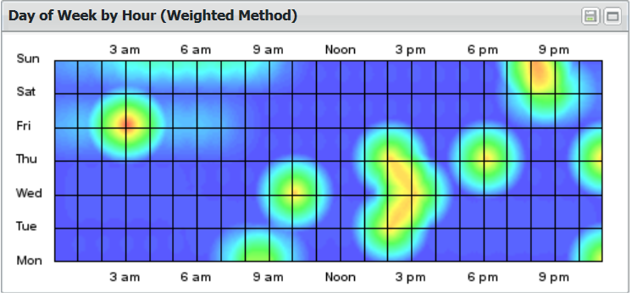

Slide 2
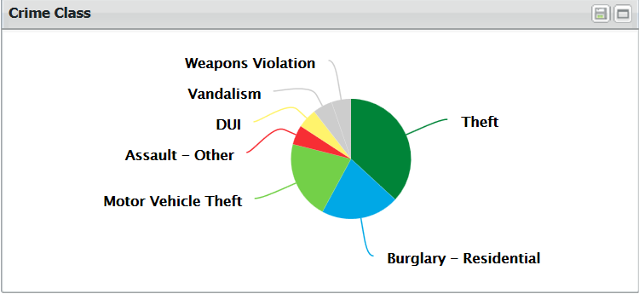

Slide 3
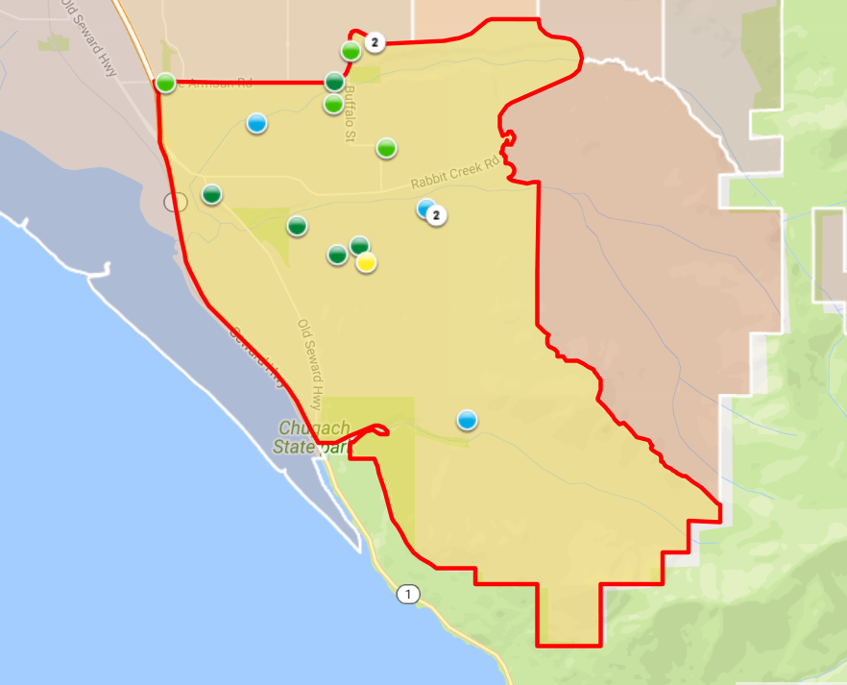
Reported events in 2017

Slide 4
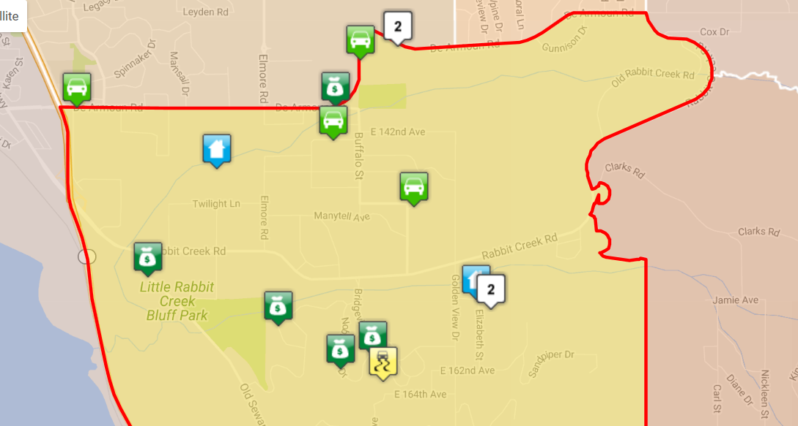
Problem Area’s

Slide 5
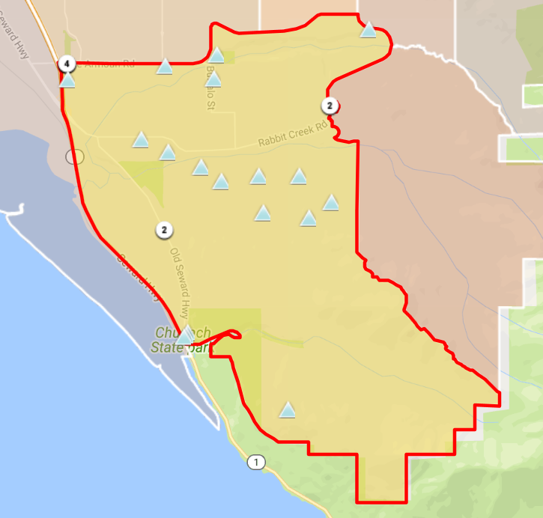
Suspicious Activity

Slide 6
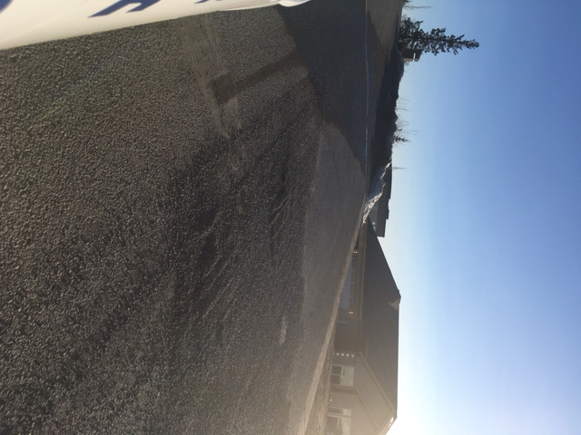
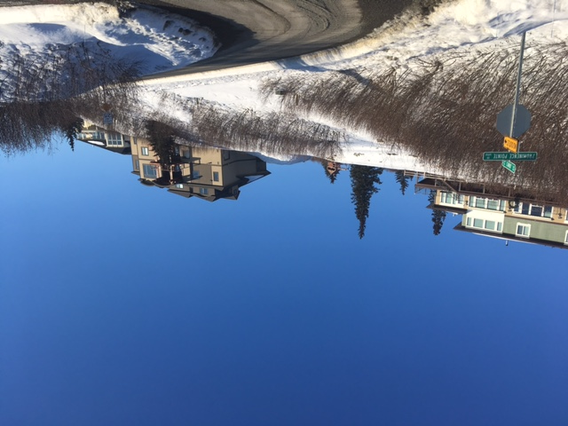
Hidden Drive ways
No fences but in summer over grown foliage

Slide 7
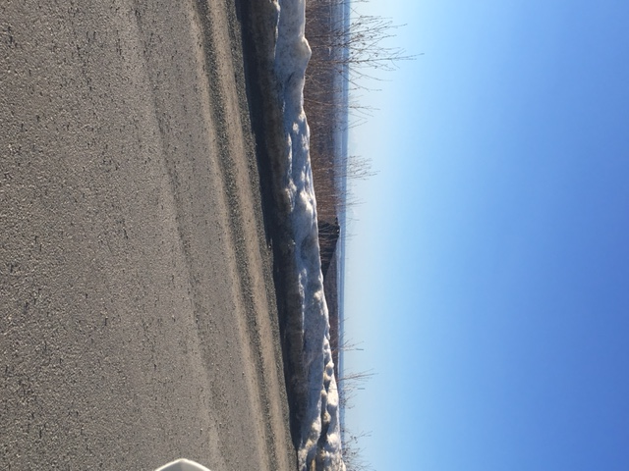
Concealed homes from roadway making
It difficult for passerby's to see suspicious
activity.

Slide 8
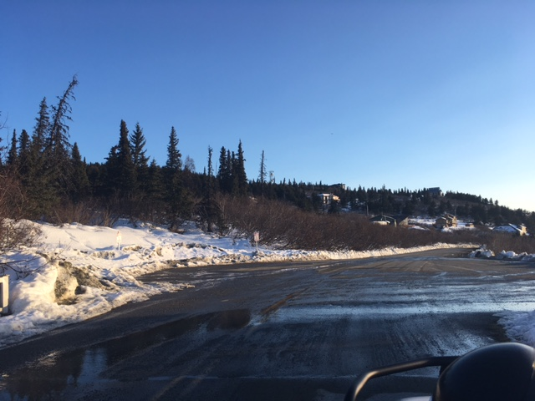
Secluded Parking Spots

Slide 9
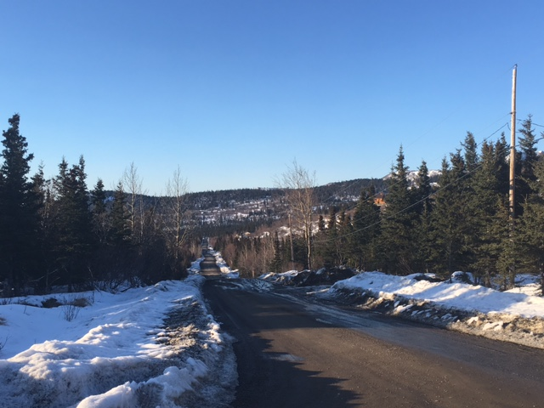
What’s suspicious?
Long dirt roads, spaced out properties
Long drive ways
Difficult to tell what doesn’t look right

Slide 10
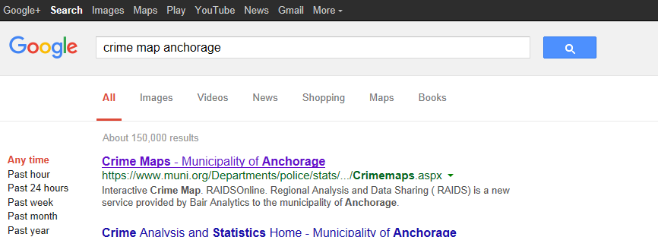
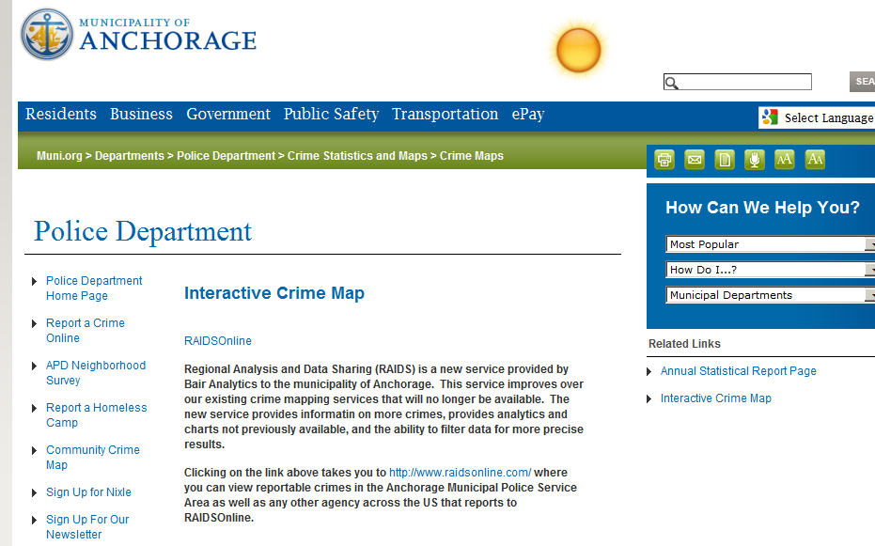

Slide 11
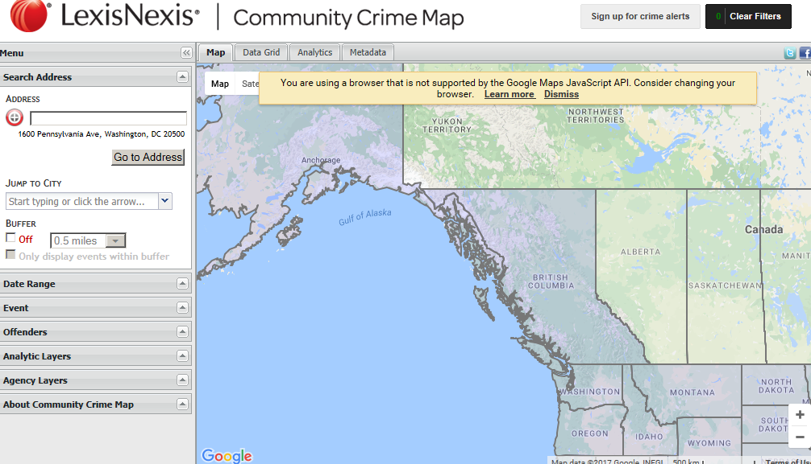

Slide 12
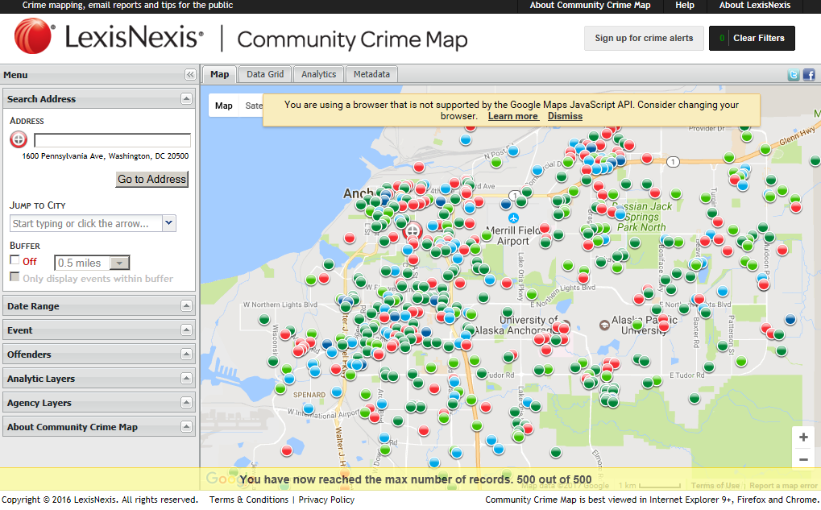

Slide 13
